Slide 1
Shared Digital Infrastructure
Launch Webinar
2024-12-04
Notes:
Lukas

Slide 2
Your Presenters
Julie Gordon
BSI
SDI Steering Committee Member
Cord Wischhöfer
DIN
SDI Steering Committee Member
Lukas Keller
SNV
SDI Chair
Notes:
Lukas

Slide 3
Agenda
Practicalities
What is SDI?
Services so far
Getting access
Participation
Q&A
Notes:
Lukas

Slide 4

Practicalities
Slides & recording published on CEN & CENELEC Experts sites > Events & Trainings
Questions addressed at the end (not recorded)
Use Q&A panel or raise hand
Notes:
Lukas

Slide 5
What is SDI?
Enabling all Members to benefits from the technical advancements (Cohesion)
Encouraging sharing the opportunities, investments and risks
Empower Members to embrace and manage digital transformation at their own pace
(Innovation, Agility)
Notes:
Julie

Slide 6




What is SDI?
CEN-CENELEC Presidential Committee
A community platform where members can provide information about their products that other members could license, or where member-to-member collaboration or co-development can be facilitated.
Reports to PC
SDI Steering Committee
Governance, financial and operational management
Marketing Platform
?
?
!
Platform manager (CCMC)
?
!
Service requester/co-developers
?
!
Service provider
Browser
IT-Infrastructure
Notes:
Julie

Slide 7

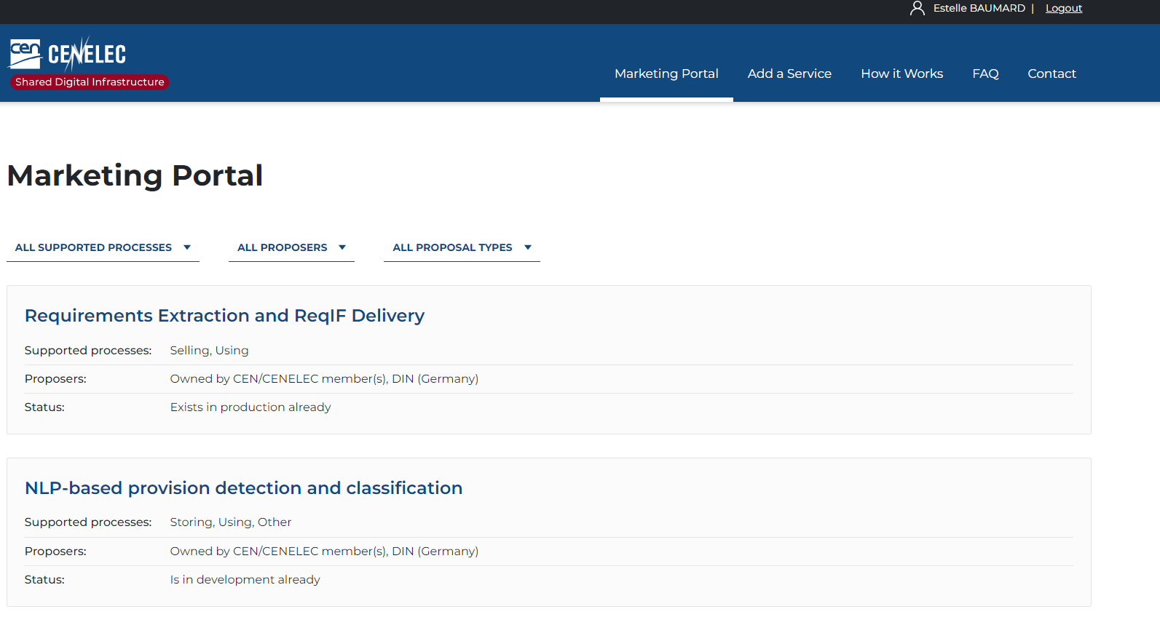

SDI Marketing portal
For each service, detailed information and contact points are provided
Link: https://sdi.standards.eu/
Members can also advertise a need of future service on the portal
Notes:
Julie

Slide 8
Services so far
Content as a Service (CaaS) – DKE
NLP-based provision detection and classification – DIN
Online Provisions Identification Service – AFNOR
Requirements Extraction and ReqIF Delivery – DIN
Term Analyzer – DKE
SD Authoring – SN
SD Enquiry – SN
SD Import – SN
SD Store – SN
SD Viewer – SN
Notes:
Cord
Examples :
Term analyzer → Provides hints for term entries from "Terms & Definitions" clauses in order to improve definition quality according to ISO/IEC Directives 2 and warns the user about wrongly stated or cyclical definitions.
Online Provisions Identification Service (AFNOR) → A HTML viewer displaying all EN, ISO and IEC standards in English or French with highlighting of 4 levels of provisions
SD Store → An end-to-end white label standards distribution service which Incorporates full product catalogue, search, subscription engine and webstore functionality.
Requirements Extraction and Req ID Delivery → The service extracts provisions (requirements, permissions, etc.) from present NISO STS-encoded DIN, CEN or ISO standards, transforms the relevant XML content into a standardized format for requirements exchange (ReqIF)

Slide 9


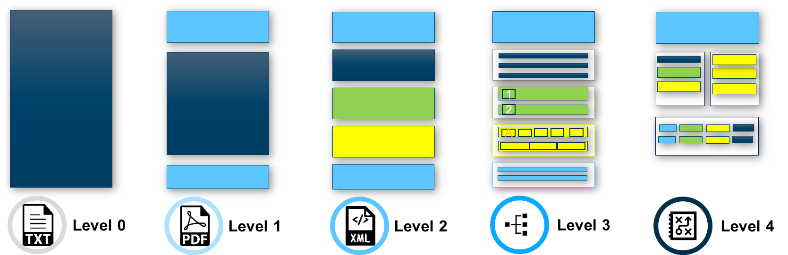
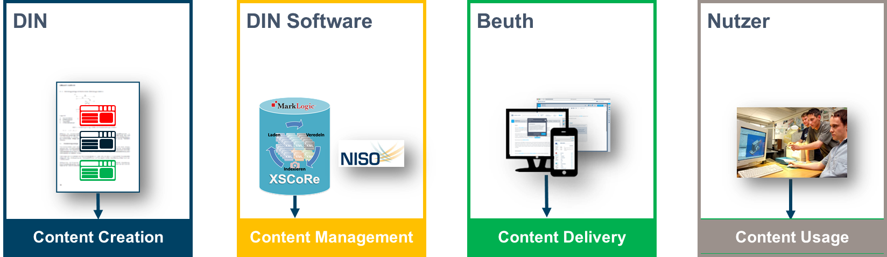

Requirements Extraction and ReqIF Delivery
Imports standards and standards information directly to your RMS:
- Siemens Polarion
- IBM Doors
- PTC Windchill
As an user, I want to feed individual fragments of a standard (e.g. requirements) into the RMS, identify the right content and link it to my own information/objects. Ideally, this happens automatically.
Section- or provision-based import
Segregation of formula, tables, images
Classifies modalities with NLP post-processing
Notes:
Cord

Slide 10
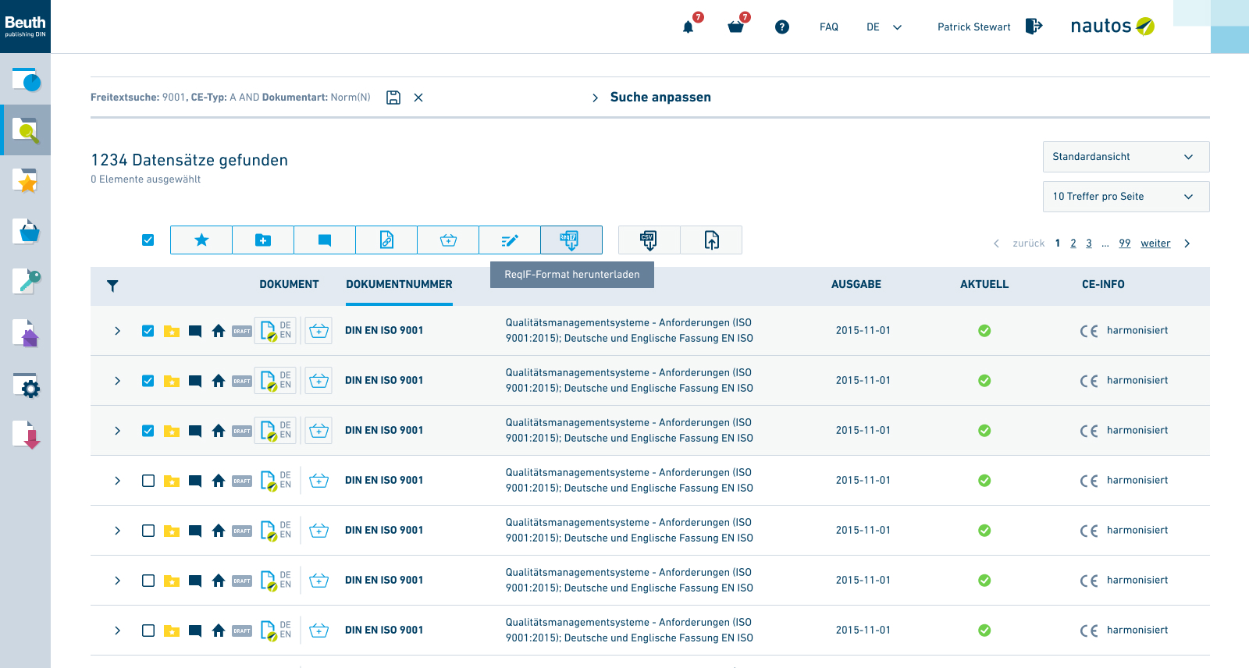
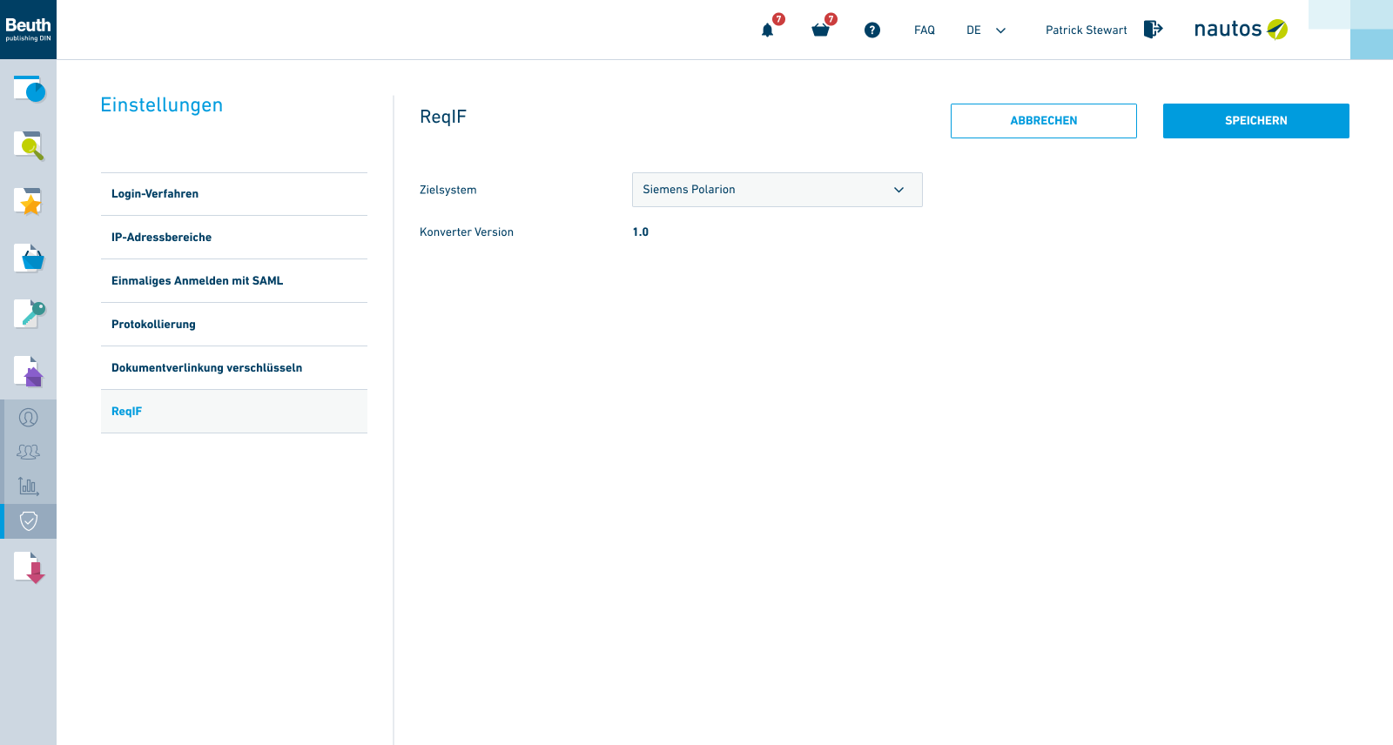
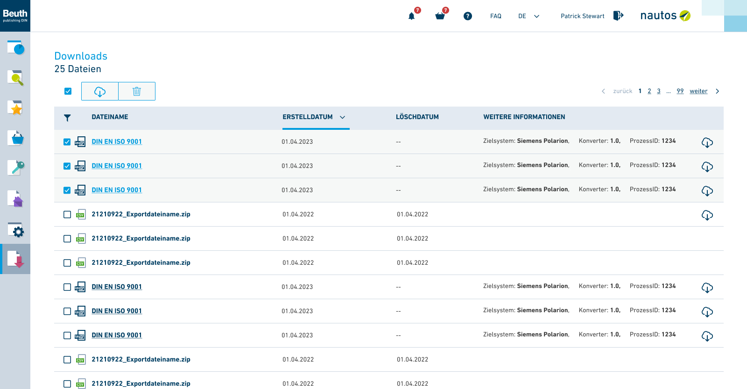
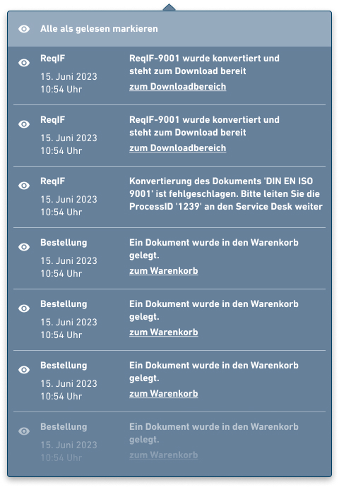
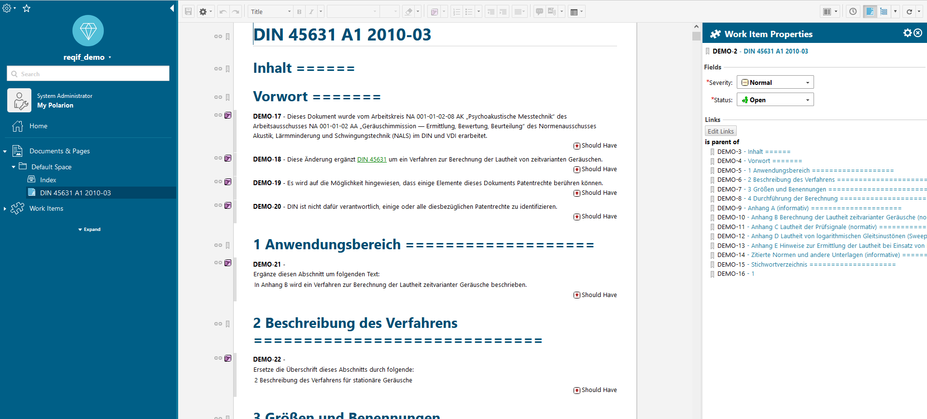

Requirements Extraction and ReqIF Delivery
Notes:
Cord

Slide 11

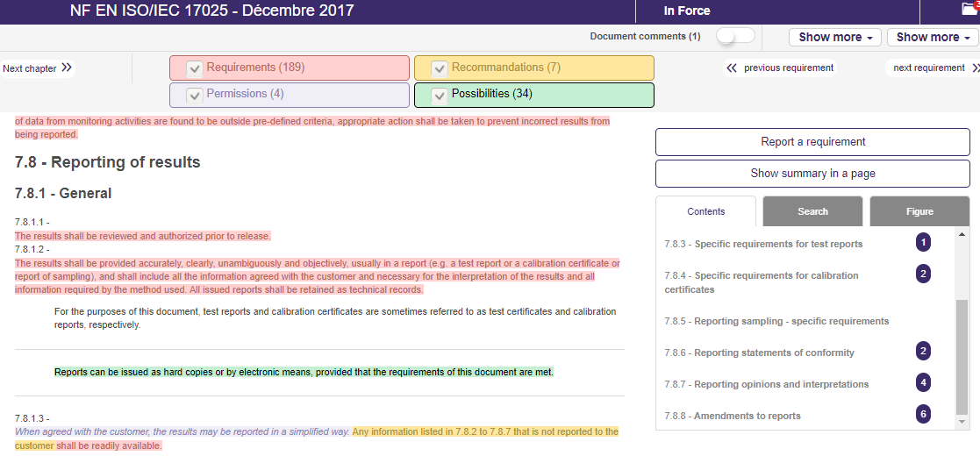
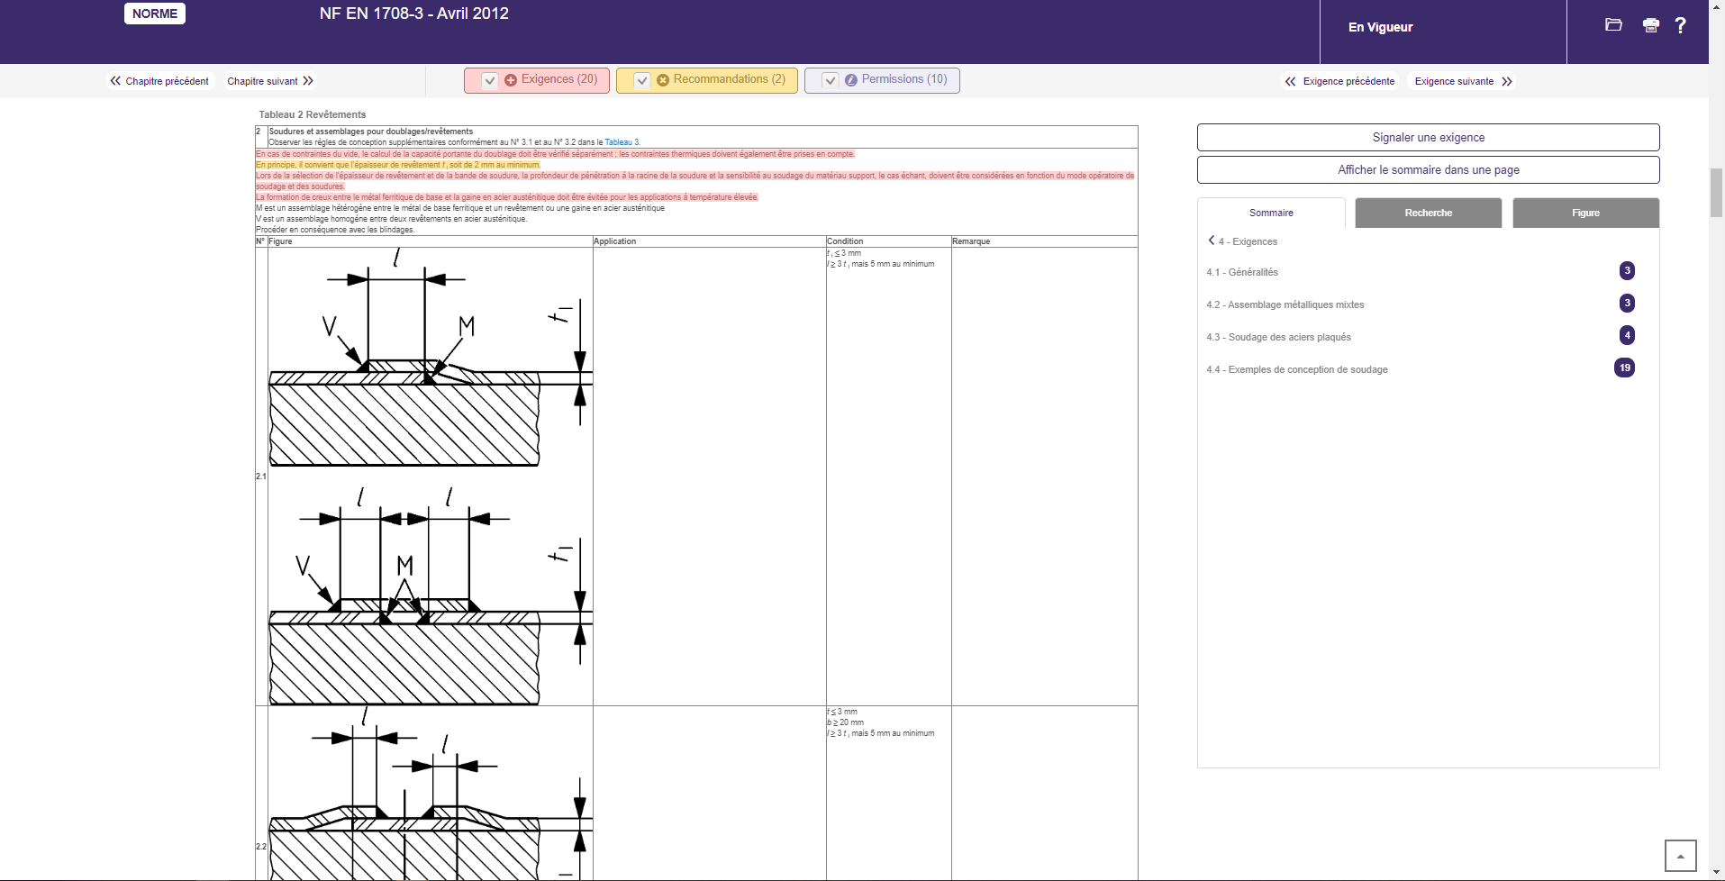
Online Provisions Identification Service
How does it work?
Several hundred expressions, verbal forms, words referring to a requirement, recommendation, possibility or permission have been determined. The texts were then subjected to the research of these terms in order to distinguish these 4 categories according to a color.
The requirements / permissions and recommendations are also indicated in the tables and figures !
Notes:
Cord

Slide 12

Getting access
& Next STEPS
Each Member of CEN and CENELEC can get access to the platform:
Link: https://sdi.standards.eu/
SDI accounts are separated from usual CEN-CENELEC accounts
Email sdi@cencenelec.eu to create your account
Max 2 users per Member for the beginning
After the Webinar:
Official email to CEN and CENELEC Members with platform link and details
Recording of the session on Experts sites
Notes:
Julie

Slide 13

AS a member I can …
Get access for 2 users of my organization to the platform
View the existing catalogue of services and associated contact person
Add a service to the catalogue
Advertise a need for a potential new service
Notes:
Julie

Slide 14
Participation
Funded by consortium of 12 interested Members
(not by CEN and CENELEC Membership fees)
Only CEN and CENELEC Members can list or browse services
SDI Steering Committee has appointed CCMC as Coordinator
CEN-CENELEC is not a party to any contracts/transactions
Notes:
Lukas

Slide 15
Questions & Answers
Notes:
Lukas

