Slide 1
OSD - CEN systems integrations (00.60 to 50.10)
2024-12-19

Slide 2
Presenters
Estelle Baumard – OSD Project Manager
Mélanie Herfurth – Functional Analyst
Aurore Mommens – Functional Analyst
Sebastien Simon – Production Expert

Slide 3
Agenda
Introduction
Create a project in OSD
OSD permissions through the drafting process
OSD document submission process
Support
Next steps
Q&A

Slide 4
Defining “CEN systems integrations”
OSD development for CEN can be divided in two parts:
Customization and implementation of the OSD tool features to fit European needs
Development of OSD tool interactions with CEN existing IT systems
Translation
Translation
EN drafting process
Authoring
In-check & editing
ENQ
Authoring & editing
FV
Editing
Publication
Available since 2024-12-10
Expected mid 2025

Slide 5
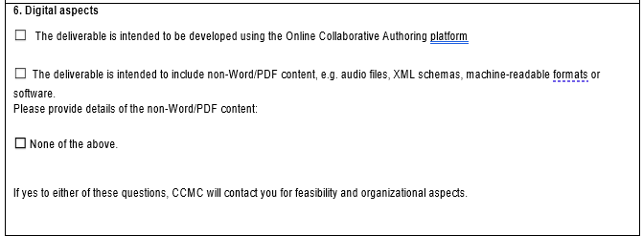
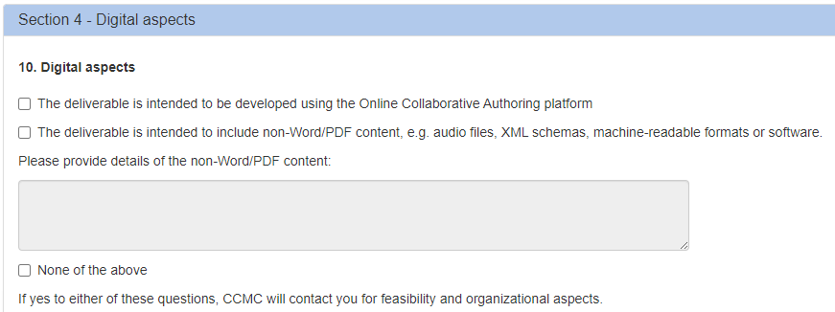
How to create a project in OSD ?
1
At PWI or WI activation
In NWI form or in Working Area, tick the box in section Digital Aspects
CCMC Data service will communicate the request and the WI number to OSD project team
OSD project team will check if the deliverable is supported ; create the document and contact OSD Leaders
When a document is created, a dynamic URL is provided to OSD Leaders of the document
https://sd.cen.eu/authoring/current/WINUMBER

Slide 6
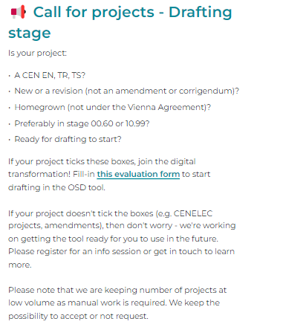
How to create a project in OSD ?
2
Once PWI or WI are already activated
On OSD project webpage, fill-in the evaluation form to request project creation in OSD
OSD project team will check if the deliverable is supported ; create the document and contact OSD leaders
When a document is created, a dynamic URL is provided to OSD Leaders of the document
https://sd.cen.eu/authoring/current/WINUMBER

Slide 7
Who is entitled to be an OSD Leader ?
Permissions and OSD roles are automatically created and refreshed in the OSD based on GD role in the drafting body assigned to the WI
Different types of roles exists in OSD : Leader, Author, Contributor, Reader, Admin, etc…
Permission matrix can be found on the CEN OSD Webpage
Permission matrix is evolving at each project stage
At project creation:
Check if the correct drafting body has been assigned to the WI
Check if everybody has the correct role in GD
If a drafting body member has not the correct role in OSD:
Check GD and OSD permissions matrix before contacting support

Slide 8
OSD roles & permissions – Authoring
 | Leader | Author | Contributor | Reader
View content | ✔ | ✔ | ✔ | ✔
Add content | ✔ | ✔
Accept/reject tracked changes | ✔
Unlock own clauses | ✔ | ✔
Unlock others' clauses | ✔
Add/delete/move clauses | ✔ | ✔
Add/delete own comments | ✔ | ✔ | ✔
Reply to others' comments | ✔ | ✔ | ✔
Resolve comments | ✔
Export | ✔
Manage author, contributor & reader roles | ✔

Slide 9
OSD roles & permissions
OSD roles | Leader | Author | Contributor | Reader
GD roles | WG Drafting Bodies •Convenor •Convenor/Sec support team •Twinned convenor •WG Secretary TC/SC Drafting Bodies •Secretary •Twinned Secretary •Secretary support team •Chairperson •Chairperson support team | All OSD roles can manually upgraded to another role by an OSD Leader. Manual upgrades are only valid by document. For an “automatic” upgrade for all documents, an appropriate role shall be granted in the GD. | WG Drafting Bodies •Committee Member TC/SC Drafting Bodies •Committee Member •Commenter | WG Drafting Bodies •Liaison representative •Document monitor •Technical programme manager TC/SC Drafting Bodies •Vice Chairperson •Liaison Representative •Committee Observer •Document monitor •Technical programme manager •CEN Consultant •Sector rapporteur

Slide 10
A dynamic permissions matrix
Submission to Enquiry
30.99
Enquiry start – ballot open
40.20
Enquiry end – ballot closed 40.60
EN drafting process
Authoring
In-check & Editing
ENQ
Authoring & Editing
Authoring state
Alternate between CCMC state and Correction state
Member commenting state
Alternate between Authoring state, CCMC state and Correction state
Authoring state:
Drafting body can modify and comment the content based on their role
Member commenting state:
National Contributors (NMCs) and Voters can provide their comments on the content
CCMC State:
Only CCMC Admin (E.g. Editor) can edit or access the content
Correction state:
Only CCMC Admin and OSD Leaders can edit the content, rest of the drafting body can view the document

Slide 11
Data modifications under TC Decision
Some metadata looks like they can be modified in OSD
Internal Regulations still prevail
A TC Decision is still needed to modify some data (e.g. titles, scopes…)
CCMC database is the correct source
OSD metadata is overwritten by the CCMC database data every night

Slide 12
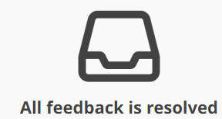
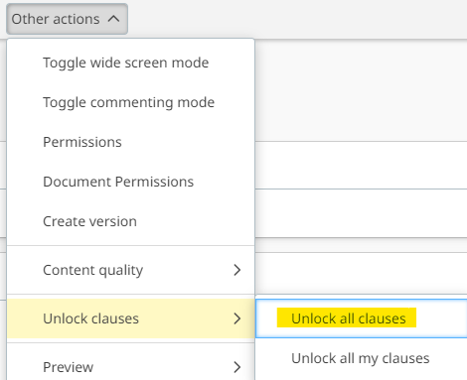
Submission
Prior to submission
Quality checks performed
WG comments resolved
Unlock all clauses
> Tools
> Other Actions
> Unlock clauses
> Unlock all clauses
/!\ locked clauses cannot be
exported

Slide 13
Submission
Submission Interface (2024-12-10)
Files not required
Word
PDF
Figure files
Justification for unusual normative references (TC decision still required)
Commenting form from previous ballot
Pending status
Automated retrieval of files
Sets to "Submitted" within a few minutes

Slide 14
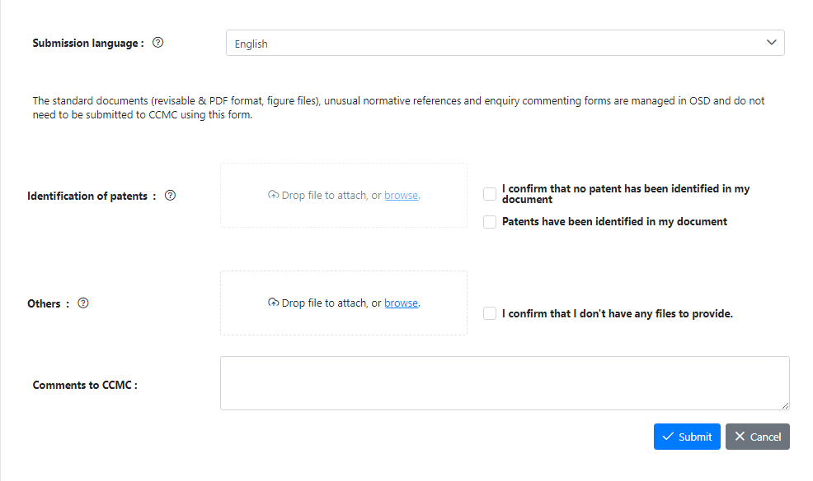
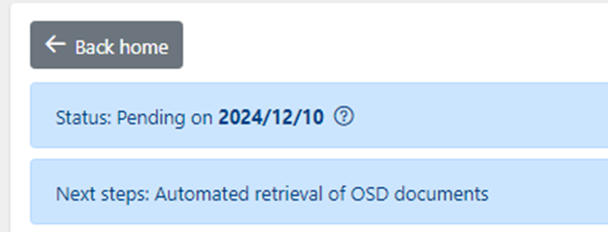
Submission
Submisssion screen
Pending status

Slide 15
Support
How to use the OSD tool ?
ISO knowledge base
CEN monthly info session Authoring – introduction to the tool to get started
ISO OSD training program – detailed training
Any question about the standards drafting process ? (submission, enquiry, etc.)
production@cencenelec.eu
Any technical issue ? (OSD server down, outages, bugs, etc.)
helpdeskcentc@iso.org
Reminder: if document is not in Authoring or Correction state, you cant’ access it

Slide 16
Next steps
Develop Formal Vote (50) and Publication (60) stages integrations with CEN systems
Expected mid-2025
Train all Voters to the CEN Member commenting module (used for Enquiry and Formal vote stages)
First pilot project until early January 2025
Training expected end of January 2025
Develop improvements to existing processes
E.g OSD Project identification in Projex Online; etc.
Expected mid 2025

