Slide 1
Webinar – eTrans for CEN and CENELEC
2022-12-15

Slide 2
Introduction

Slide 3
eTrans – Draft/published standards distribution channel
Approach - Platform
Distribution channel with members (TCs will use other channels)
Stay as close as possible to the ISO solution (ISO ICE)
No change in the translation process
Submission interface (launched 28/11)
Projex Online (launched 28/11)

Slide 4
Trans
Members
TCs
Trans
Members
TCs
eTrans (Livelink)
eTrans (NUXEO)
Projex
Online
SI
CCMC
CCMC

Slide 5
eTrans – Draft/published standards distribution channel
Approach - Platform
Stable location for project folder from its initial creation​ (WIID)
Unambiguous relation between a document and the related WI
Same navigation as in ISO
Same ZIP files and filename conventions (Note: Moving towards standalone files (word, PDF, XML) will be considered later)
Structure based on work item ID instead of TC

Slide 6
eTrans – Draft/published standards distribution channel
Approach - Migration
Migration of all the complete collection of formal documents
stable delivery enquiry
enquiry draft
vote draft
Published
In all available formats (Word/PDF, XML)
➔ All documents (200.731 document)
➔ 99,8 % of the documents properly migrated

Slide 7
eTrans – Draft/published standards distribution channel
Approach - Migration
Migration of the working documents
stable delivery vote
Translation returns
In all available formats (Word/PDF, XML)
➔ All documents from last 3 months (2022-08-29)
➔ Stable delivery vote (430) 95,2 %
➔ Translation returns (1142) 98,8 %
first delivery
➔ First delivery (396) 32 %

Slide 8
eTrans – Draft/published standards distribution channel
Approach - Migration
No migrations of the former versions (technical versioning) of a given document; Only the latest version is migrated.

Slide 9
In practice

Slide 10
Accessing eTrans
Direct link:
https://etrans.cen.eu/
You can also access it from the CEN expert homepage:
CEN Expert Area - Experts

Slide 11
Nuxeo Root Structure
E-Trans
CEN (domain)
CENELEC (domain)
CEN-CENELEC (domain)
Standards
Standards
Standards

Slide 12
Nuxeo Project Structure
Phase (including iteration)
Stable Delivery
Voting Report
WI ID
Standards
Translation Returns
French
German
English
Zip
Zip
Zip
Zip
First Delivery
Word and PDF
XML
Word and PDF
Zip
Zip
Zip
XML
Zip
Zip
Container
Document

Slide 13
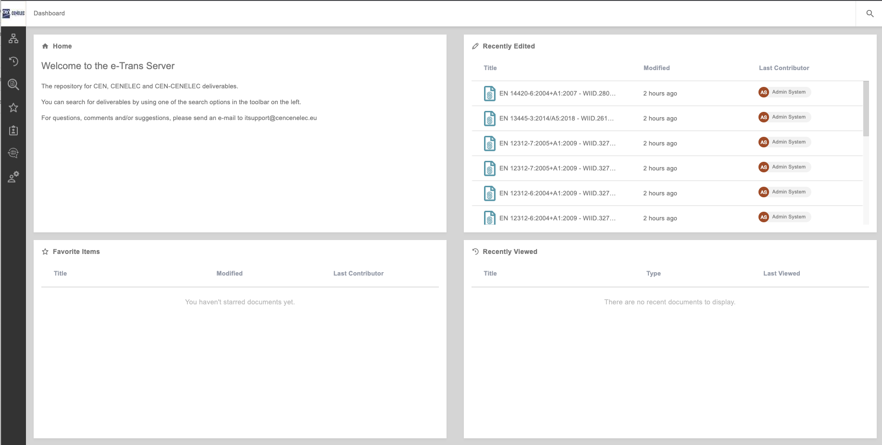
Home screen
Items recently modified or uploaded
Navigation menu
Items marked as favorites
Recently viewed items

Slide 14
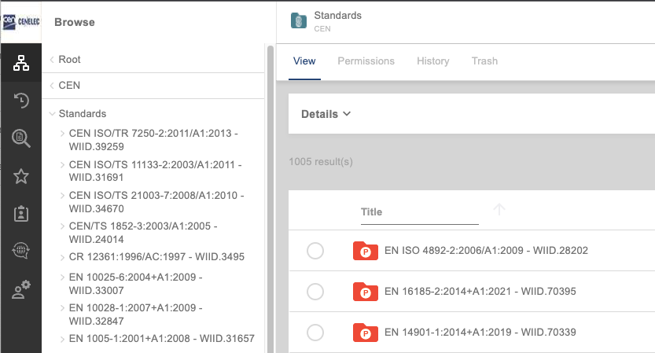
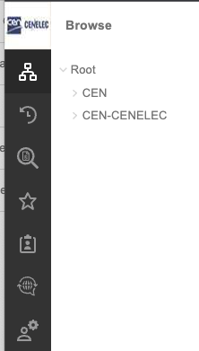
Navigate the root and project structure
1. Click on Browse in the Navigation menu and choose your domain
2. Choose the WI you wish to see from the list

Slide 15
Mark an item as favorite
You can mark any item as a favorite:
Projects
Folders
Document
Navigate to the item you want to add a favorite and click on the star
It turns blue when activated

Slide 16
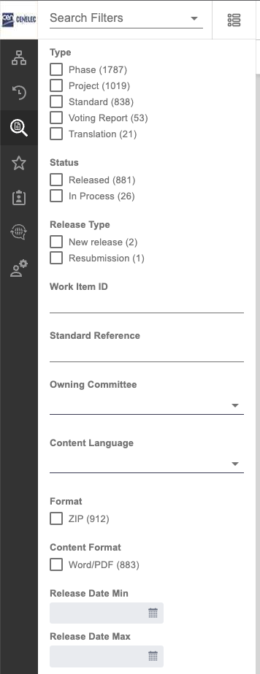
Search for work items
1. Click on Search in the Navigation menu
2. Enter the search criteria

Slide 17
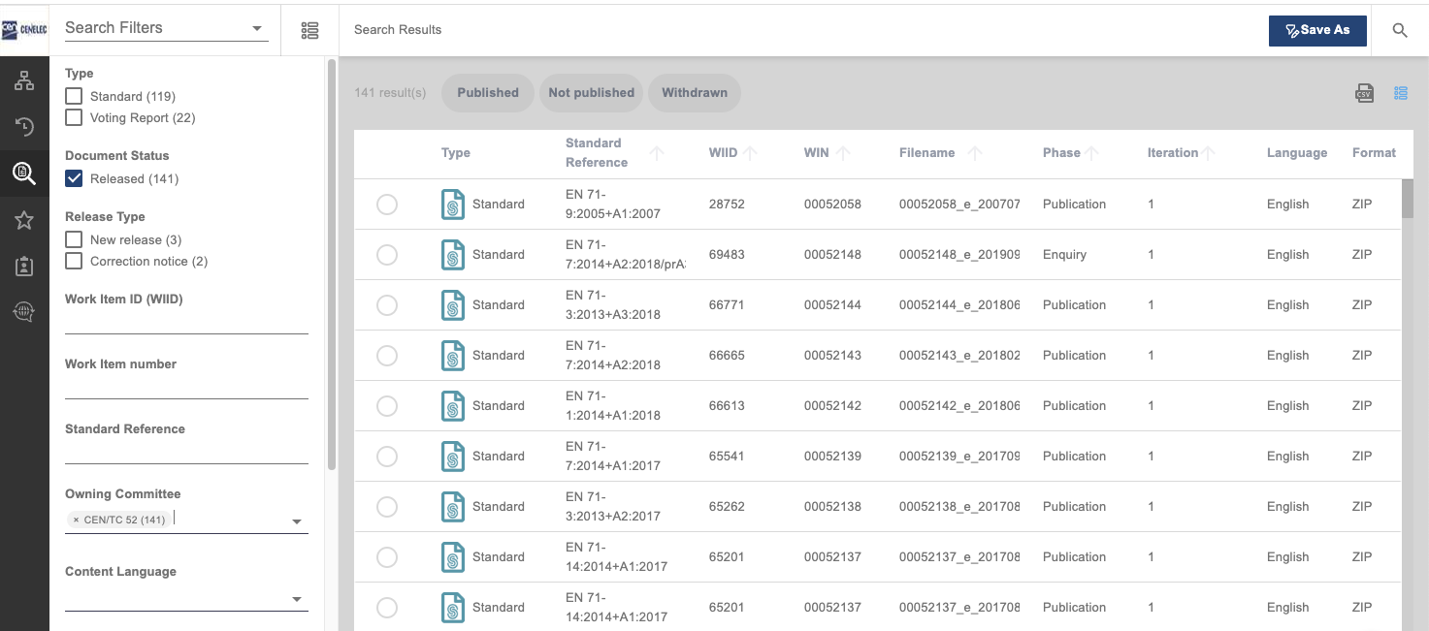
Save a search
2. From the dropdown menu, select your saved search to view results
1. Click on “Save as” to save you search

Slide 18
Need help?
Please do not hesitate to inform us at itsupport@cencenelec.eu

